Slide 1
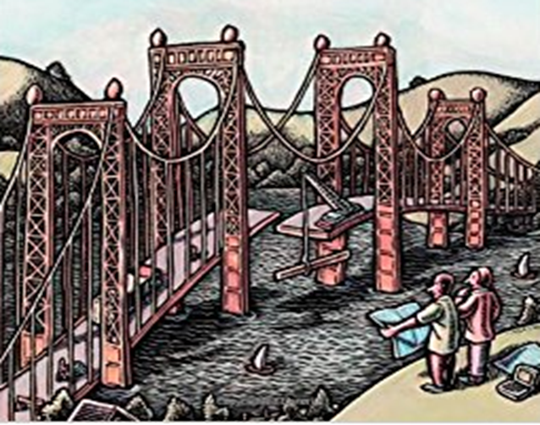
Implementation Models
(Component Model)

Slide 2
Component Diagram
We discussed on the class diagram and details on how they would structurally represent the objects of the problem space. We also discussed on how a Class Model depicted as Class diagrams represented the relationship between these objects as part of the object oriented approach of designing a system
There are two dimensions for a software intensive system
Logical dimension
Addressing the classes, Interfaces, Collaborations, Interactions, States etc.
Physical dimension or Implementation dimension which is represented by
Components which represents the physical packaging of these logical things
Nodes which represent the hardware on which these components are deployed and executed
Thus, couple of other static models which we will consider to complete the physical perspective would be Component Model and Deployment Model

Slide 3
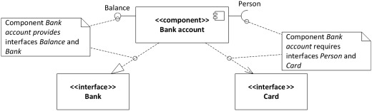
Component Diagram
When modelling large object-oriented systems, it is necessary to break down the system into manageable subsystems.
A component diagram represents the actual physical software components and their dependencies.
The UML component diagram shows how a software system will be composed of a set of deployable components (represented as diagrams) —dynamic-link library (DLL) files, executable files, or web services—that interact through well-defined interfaces and which have their internal details hidden. Thus

Slide 4
Component Diagram
Components are autonomous units within a system, which are replaceable and executable piece of a system whose implementation details are hidden
Components can be used to define software systems or subsystems of any size and complexity
Component diagram describes the organization and wiring of the physical and the conceptual stand-alone components in a system (hence its also called a wiring diagram)
A component diagram shows the internal parts, connectors, and ports that implement a component. When the component is instantiated, copies of its internal parts are also instantiated.
Component diagrams are essentially class diagrams which are organized to focus on a system's components that often are used to model the implementation view of a system..

Slide 5
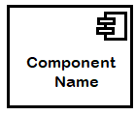
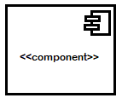
Component Diagram Notations : Component Notation
Typically a component is represented as below
Rectangle with the component stereotype (the text <<component>>). The component stereotype is usually used above the component name to avoid confusing the shape with a class icon.
Rectangle with the component icon in the top right corner and the name of the component
Rectangle with the component icon and the component stereotype.

Slide 6
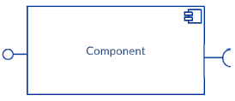
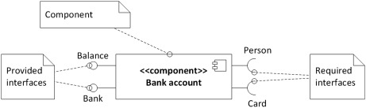
Component Notation/Representation
Thus a component represents a modular part of a system that encapsulates its contents, it defines it behavior in terms of provided and required interfaces.
It serves as a type whose conformance is defined by the provided and required interfaces (encompassing both their static as well as dynamic semantics) as a basil and a socket. One component may therefore be substituted by another only if the two are type conformant.
Required Interface
Provided Interface

Slide 7
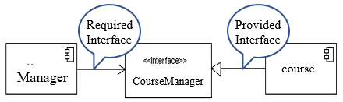
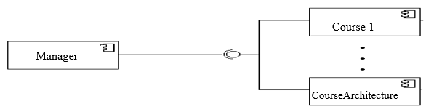
Component Diagram : Interface
An interface can also be shown using a rectangle symbol along with dependency arrows
In a system context where there are multiple components that require or provide a particular interface, a notation abstraction can be used that combines by joining the interfaces

Slide 8

Component Diagram : Usage Dependency
Components can be connected by usage dependencies.
Usage Dependency
A usage dependency is relationship which one element requires another element for its full implementation
It is a dependency in which the client requires the presence of the supplier
It is shown as a dashed arrow with a <<use>> keyword
The arrowhead point from the dependent component to the one of which it is dependent on

Slide 9
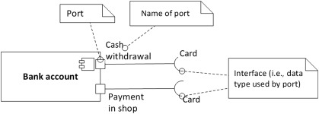


Component Diagram : Port
Port specifies a distinct interaction point or a window into an encapsulated component shown as a small square
Each port provides or requires one or more specific interfaces.
Ports can be named, and the name is placed near the square symbol
There can be multiple ports providing or requiring the same interface. It allows greater control over implementation and interaction with other components.
Can support uni directional communication or bi-directional communication
The internals are fully isolated from the environment
This allows such a component to be used in any context that satisfies the constraints specified by its ports

Slide 10
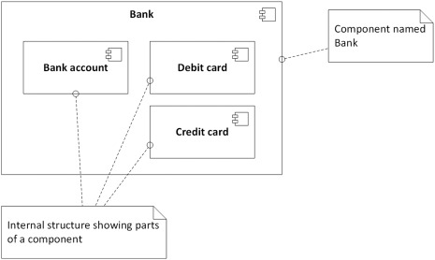
Component Internal Structure
Used to specify structure or white box view of a complex component, i.e., typically smaller components building up the larger component and the system.
Part : A component that builds up internal structure of a more complex component. You can consider part as a subcomponent.
Connector: A relation between ports of components. If one port provides interface required by the other port, they can be linked together.

Slide 11
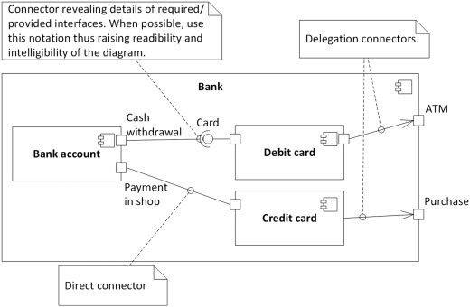
Component Diagram : Connector
There are several types of connectors that we can draw between parts and components:
A direct connector links together two ports of parts
A connector by interfaces or assembly connector links together two ports by relating together the required and the provided interfaces using ball and socket notation
A delegation connector which links together port of a part and port of a component thus providing interface (i.e., provides services to other components) or requiring interface (i.e., consuming services of another component)
also called Assembly connector
or

Slide 12
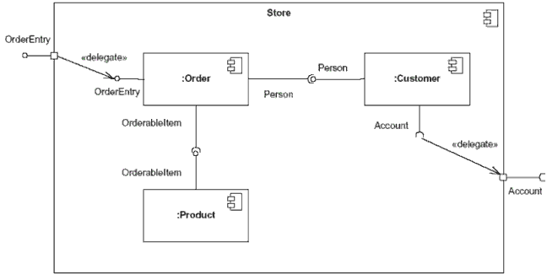
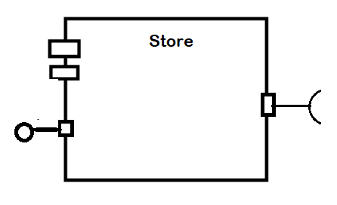
Internal or External View of the Component
Internal View External View
An external view (or black box view) shows publicly visible properties and operations
An internal, or white box view of a component is where the realizing classes/components are nested within the component shape

Slide 13
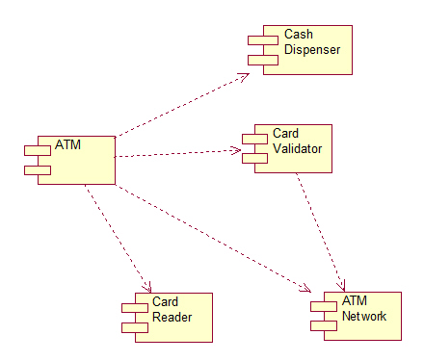
E.g. Component Diagram for an ATM component

